Slide 1
PSYKICK
Group No. 18
Guided By: Prof A.M. Bhadgale sir

Slide 2
Problem Statement:
Traditional depression detection methods using only questionnaires are often unreliable and incomplete.
Proposed Solution:
Psykick integrates quizzes with facial expression and voice analysis to provide a more accurate depression assessment.

Slide 3
Introduction
PsyKick
Depression is a widespread mental health issue affecting millions worldwide, but detecting it early and accurately remains a challenge.
Psykick is a modern solution that aims to enhance depression detection by combining psychological quizzes with advanced facial expressions and voice tone analysis.

Slide 4
Motivation:
Global Need for Accurate Depression Detection Depression is underdiagnosed globally, with traditional methods like questionnaires often being unreliable and incomplete.
Limitations of Traditional Screening People's answers on questionnaires can be influenced by their mood, desire to give socially acceptable answers, or inability to fully express their emotions, leading to less accurate mental health assessments.
Leveraging Modern Technology Psykick integrates facial expression and voice analysis with quizzes to detect subtle emotional cues, providing a more objective, comprehensive assessment.
Accessibility and Timely Intervention A scalable, user-friendly platform that offers real-time mental health assessments, empowering early detection and intervention.
Potential for Professional Integration Psykick can be a vital tool for healthcare professionals, enhancing the accuracy of diagnosis and follow-up care.

Slide 5

Scope:
01
02
03
04
05
Detect depression through quizzes, facial expressions, and voice analysis.
Provide users with real-time, accurate mental health assessments.
Offer a scalable platform accessible to a wide range of users.
Potential integration with
healthcare professionals for further diagnosis and support.
Utilize AI-driven emotion detection for improved accuracy in depression screening.

Slide 6
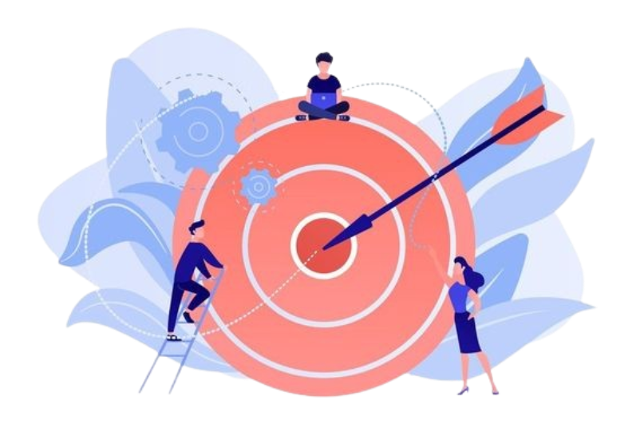
Objective:
01
02
03
04
Combine quiz, facial expression, and voice analysis.
Provide accurate depression assessments.
Ensure a user-friendly and secure experience
Build a website for depression detection.

Slide 7
Agile Model
How it Works?
1. Iterative Development: Delivers working software in small sprints.
2. Frequent Testing: Catches bugs early with continuous integration.
3. Adaptability: Allows for changes based on feedback or conditions.
4. Continuous Delivery: Ensures frequent updates with functional versions.

Slide 8
Why Agile Model in Psykick?
Allows flexibility while ensuring essential requirements are met.
Agile lets you build the tool step-by-step and make changes based on feedback.
User feedback helps you improve the system early and often.
Machine learning models can be tested and improved in small parts.

Slide 9
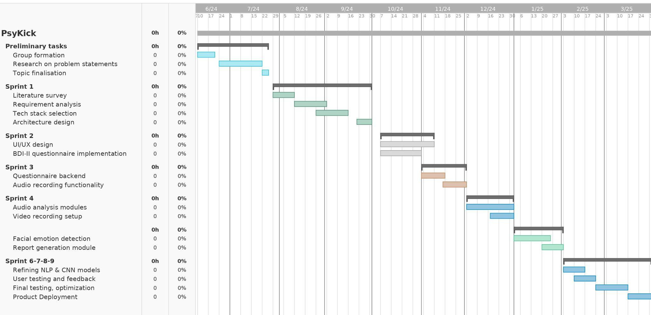
Project Plan:
Sprint 5

Slide 10
Literature Review 1
TITLE : | Machine Learning Algorithms for Depression: Diagnosis, Insights & Research Directions
ISSUED : | 2022
PUBLISHERS : | Shumaila Aleem, Noor ul Huda, Rashid Amin
INSTITUTE: | University of Engineering & Technology, Pakistan ; AI Baha University,Saudi Arabia
DESCRIPTION : | It enlists different ML algorithms used to detect and diagnose depression. These algorithms are classified into three classes: classification, deep learning and ensemble. A general model for depression diagnosis involving data extraction, Ml classifier, detection, classification and performance evaluation is presented.
LINK : | https://www.mdpi.com/2079-9292/11/7/1111

Slide 11
Literature Review 2
TITLE : | Depression detection using emotional AI and ML: A closer review
ISSUED : | 2022
PUBLISHERS : | Manju Lata Joshi, Nehal Kanoongo
INSTITUTE: | International School of Informatics & Management, Jaipur
DESCRIPTION : | This study analyses how facial expressions, images, emotional chatbots and texts on social media platforms can be effectual in detecting one’s emotions and then depression. Naive-Bayes, Support Vector Machines (SVM), Long Term Short Memory (LSTM) ,etc. are various ML techniques used to recognize emotions.
LINK : | https://www.sciencedirect.com/science/article/abs/pii/S2214785322005430

Slide 12
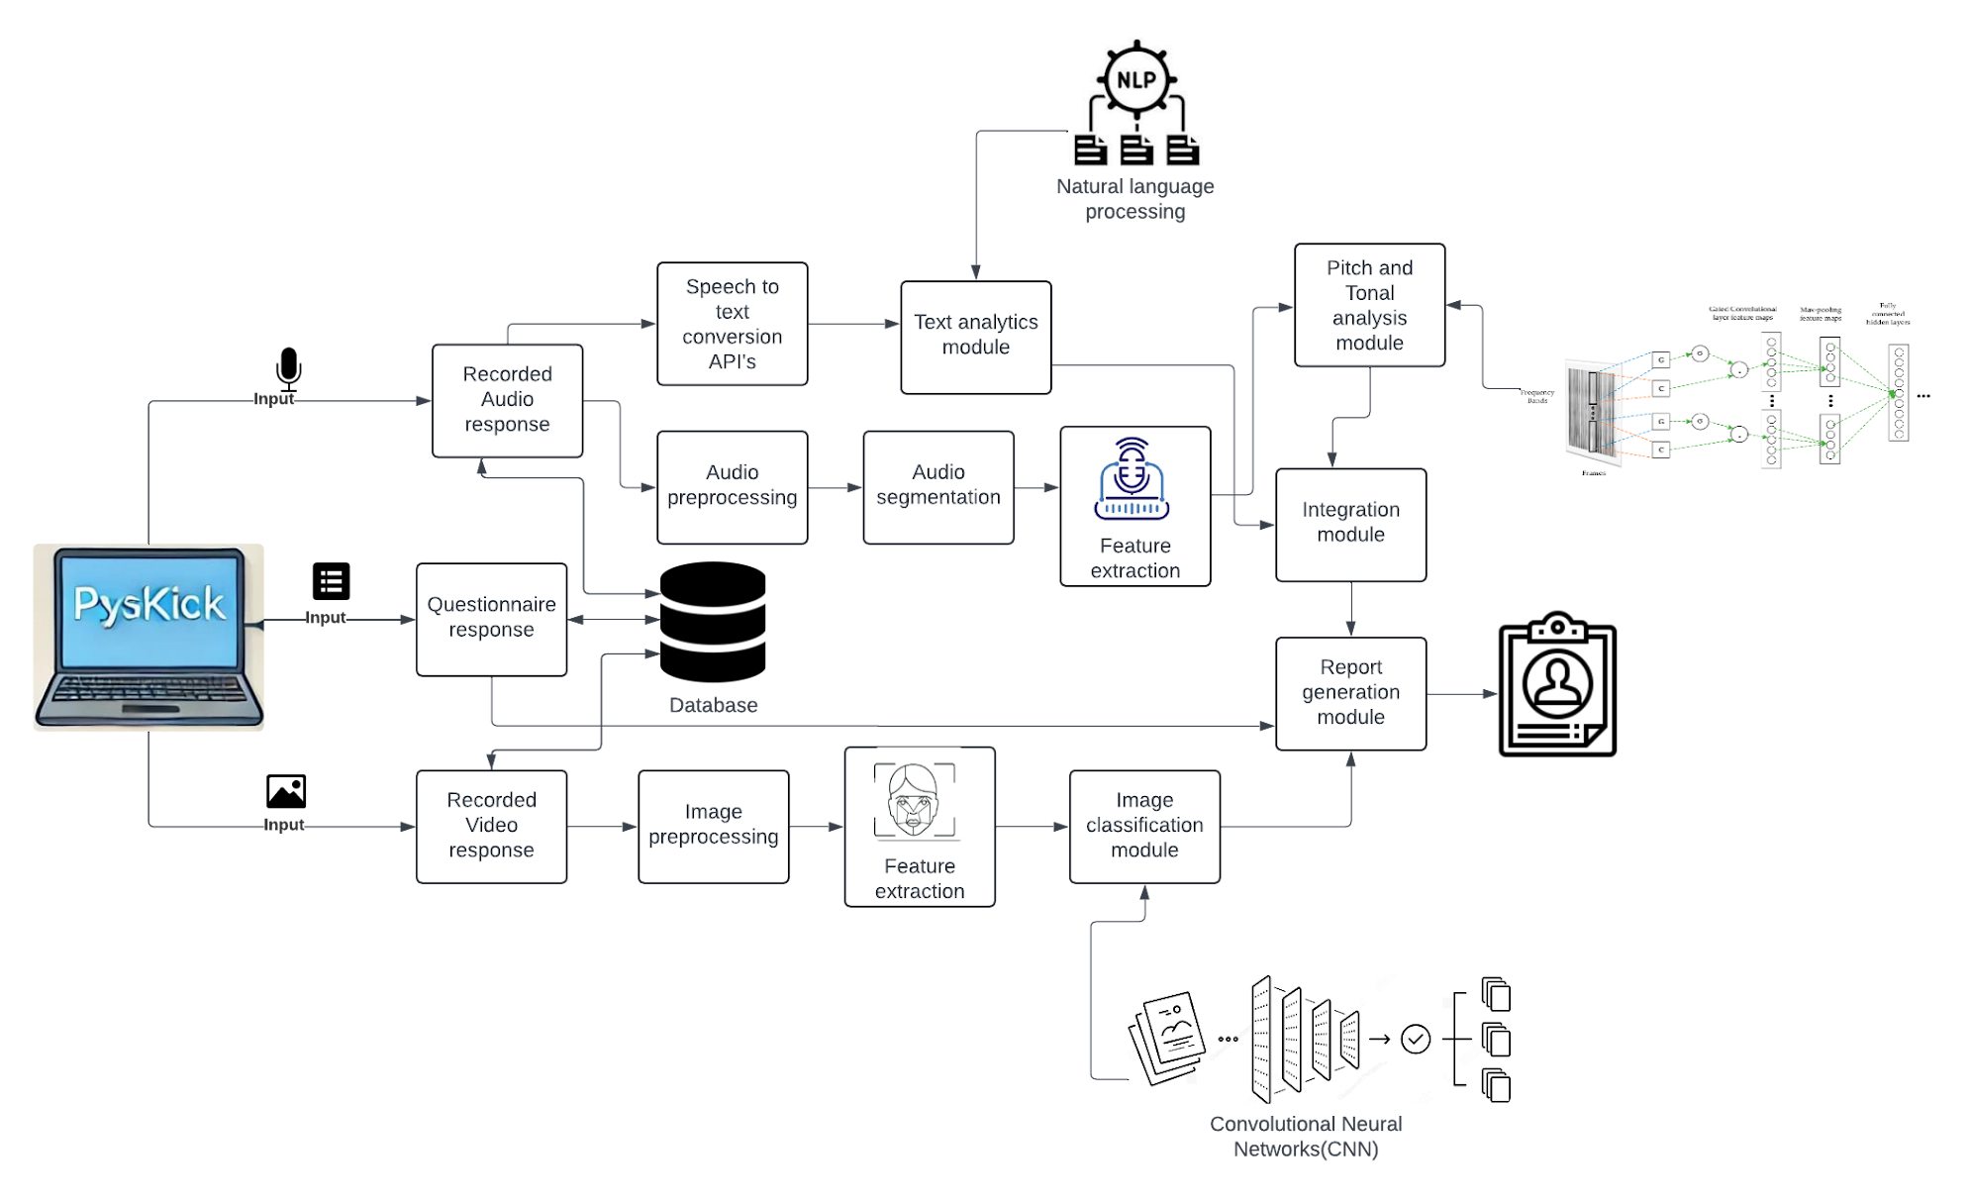
Architecture Diagram

Slide 13
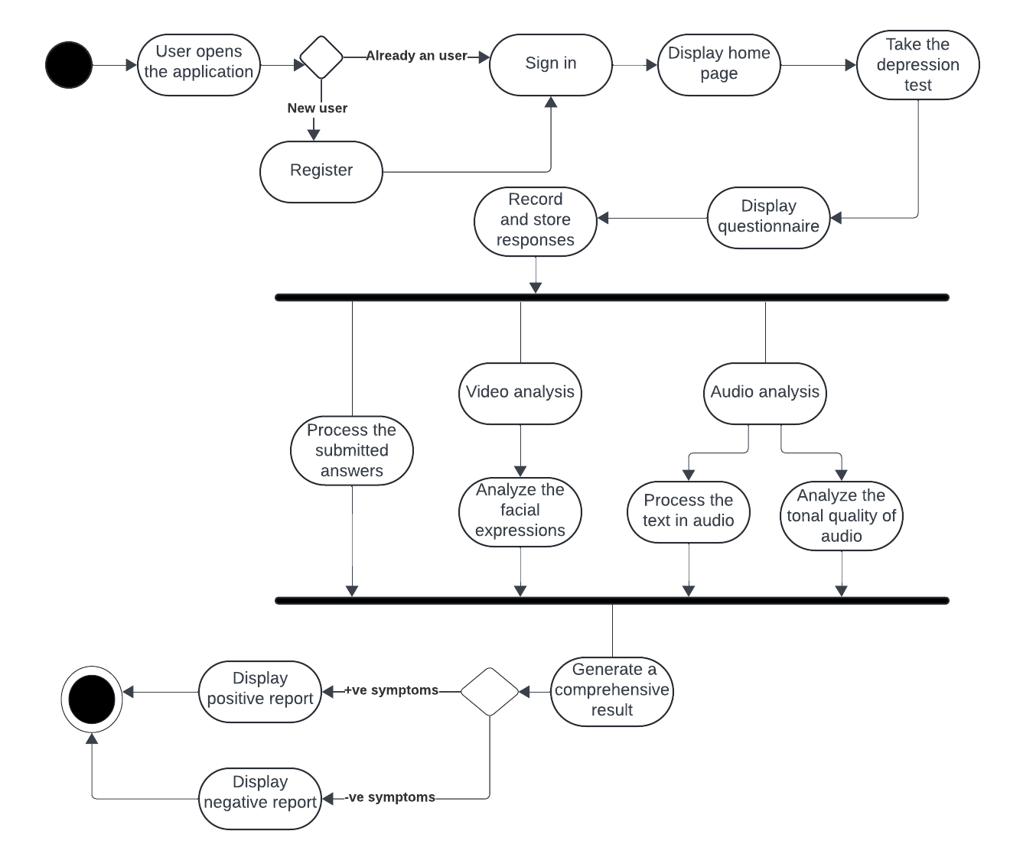
Activity Diagram:

Slide 14
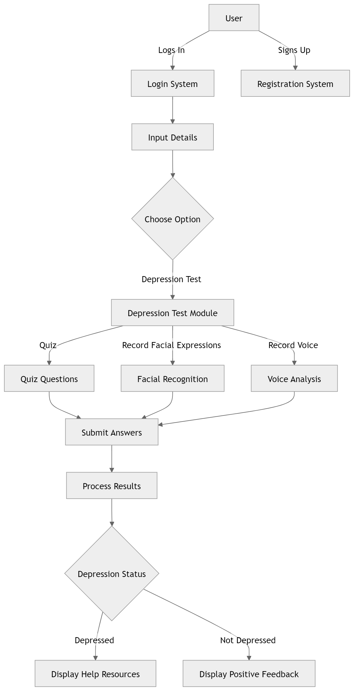
Flowchart:

Slide 15
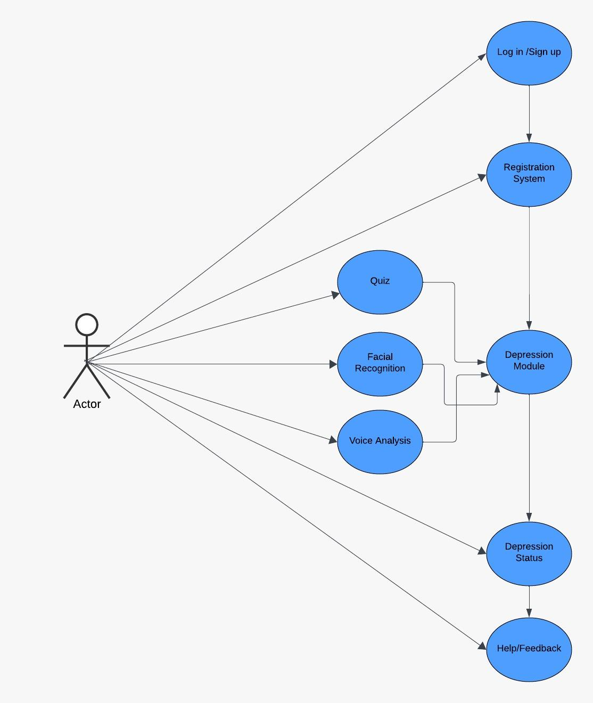
Use case Diagram:

Slide 16
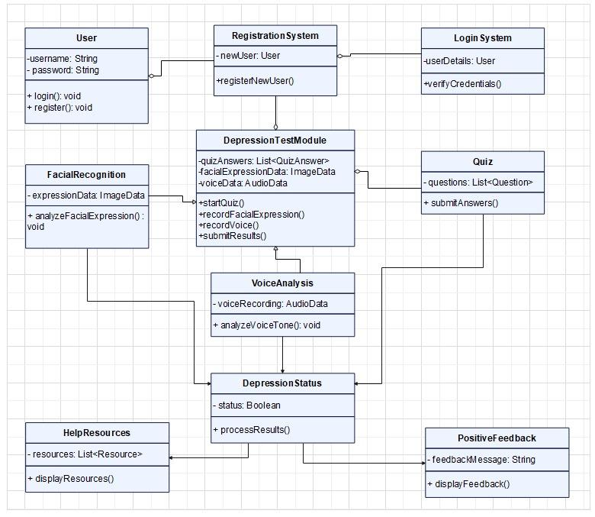
Class Diagram:

Slide 17
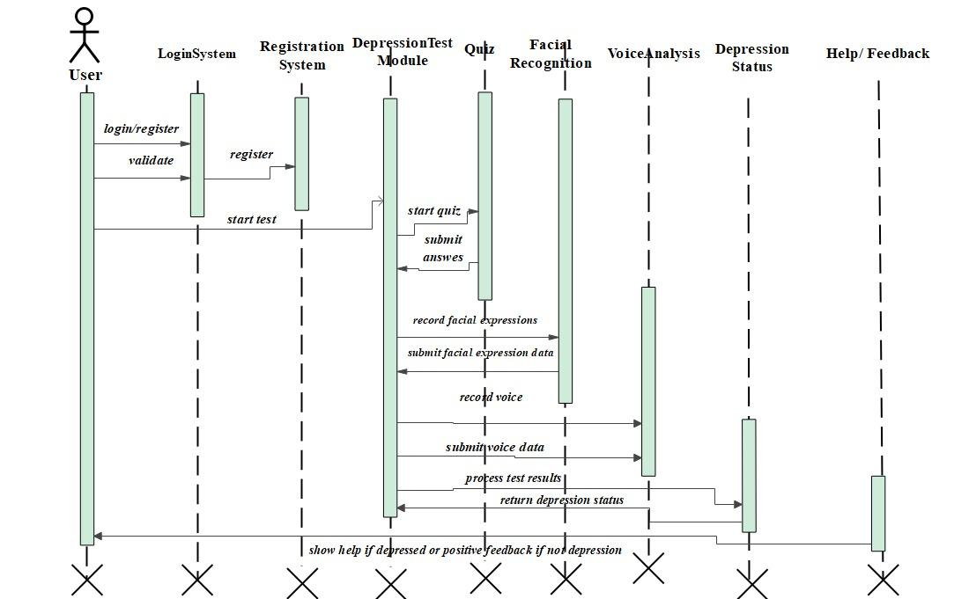
Sequence Diagram:

Slide 18

Functional requirement
User Management
Questionnaire Analysis
Audio Analysis
Video Analysis
Report Generation

Slide 19

Non-Functional requirement
Scalability
Performance Requirements
Security Requirements
Reliability Requirements
Usability Requirements

Slide 20
Acceptance criteria
Facial Data Collection
Voice Data Collection
Result
Display

Slide 21



Hardware Requirement
Server
Client
Network
CPU, RAM, GPU
Processor, RAM, Webcam, Microphone
Stable Internet connection

Slide 22



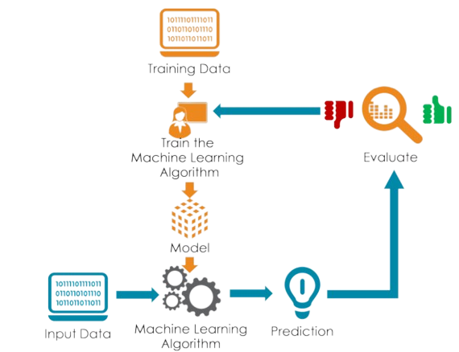
Software Requirement
Frontend
Backend
Databases
React.js,
HTML, CSS, Javascript
Python, Node.js/Express.js
MongoDB
Machine learning models
TensorFlow/Keras,
OpenCV, Librosa,
Numpy, Scikit-learn

Slide 23
Project Modules

Slide 24
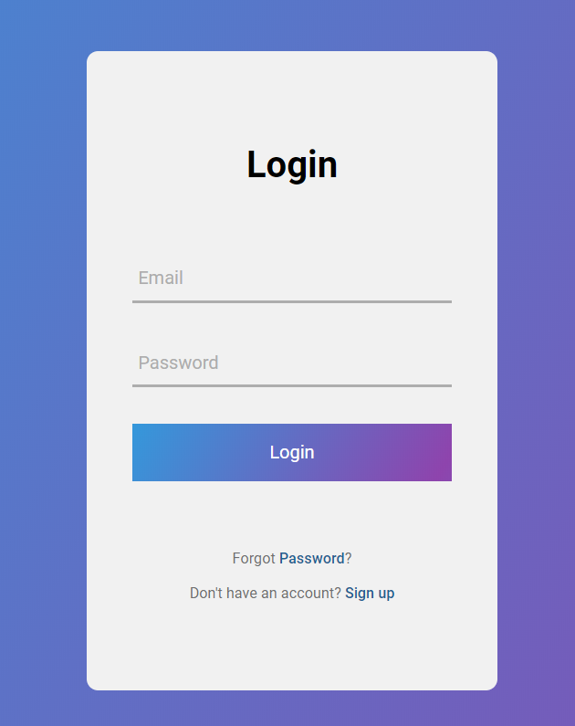
Module 1
User Module
Log In
Sign Up
Existing users log in
New users create an account

Slide 25
Module 2
Dashboard Module
Dashboard
Central hub where users can view their profile, previous depression test results, and initiate new tests

Slide 26
Module 3
Depression Test Module
Voice analysis
Quiz
Records and analyzes the user’s voice for emotional markers, tone changes, and pauses to assess the user’s mood.
Users answer a set of quiz questions designed to assess their mental state.
Facial recognition
Uses computer vision to analyze the user’s facial expressions in real time to detect signs of depression.

Slide 27
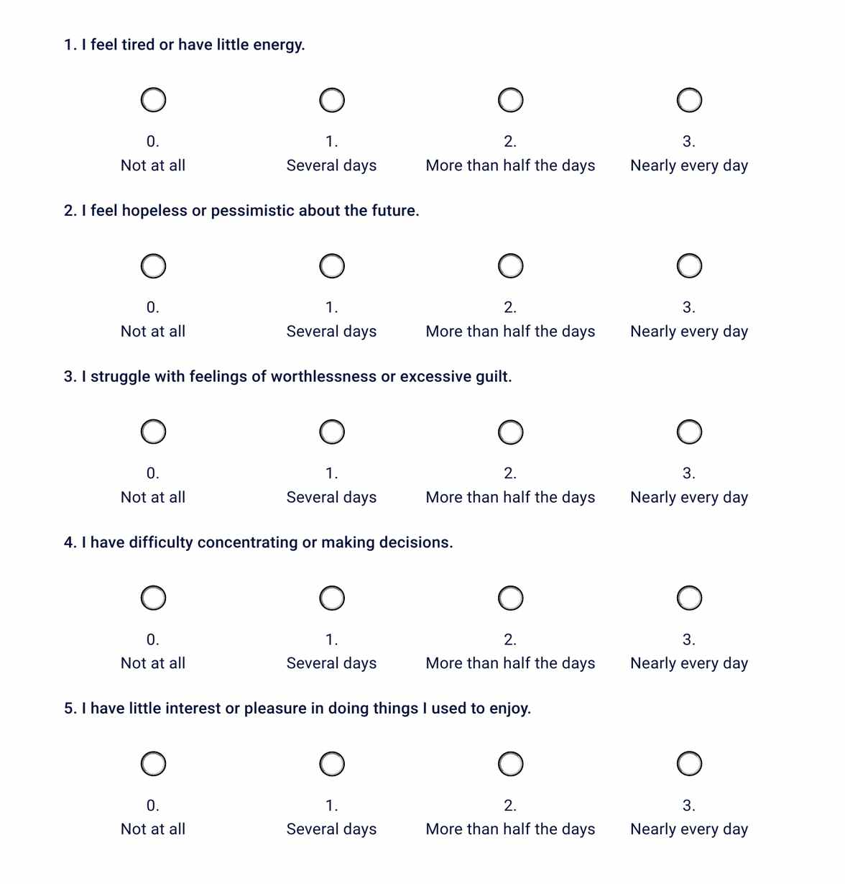
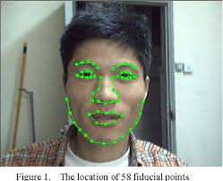
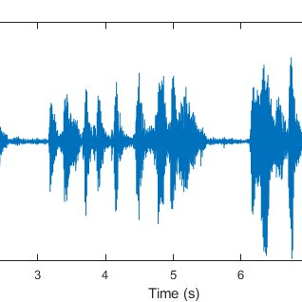

Slide 28
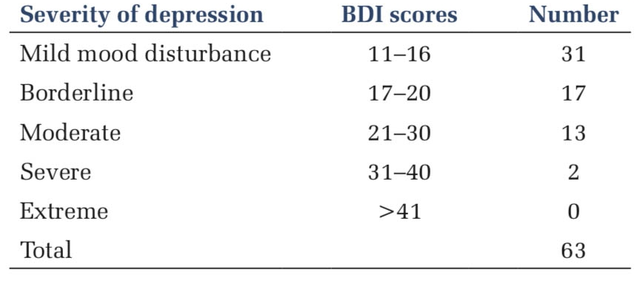
Module 4
Processing & Analysis Module
Processes the data collected from the quiz, facial recognition, and voice analysis.
Module 5
Depression Status Module
Determines whether the user is depressed or not based on the analyzed data.

Slide 29
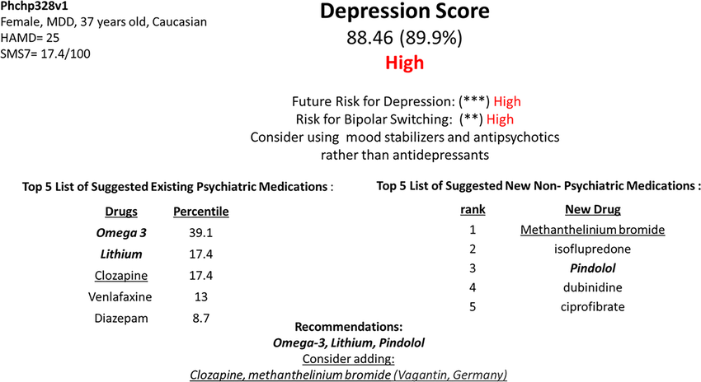

Module 6
Feedback Module
Based on the depression status, users receive relevant feedback

Slide 30
Conclusion :
Psykick provides an easy and efficient mechanism for quick mental health detection, ensuring timely intervention and support.
By using advanced voice and facial analysis, combined with the well-established BDI questionnaire, it delivers a thorough and reliable assessment of an individual's mental well-being.
This approach enhances the accuracy and depth of the mental health evaluation process.

Slide 31
References
Depression Detection and Analysis Using Deep Learning: Study and Comparative Analysis- Published in IEEE 2021
Emotion Detection for Supporting Depression Screening- Published by Multimedia tools and Applications, 2022
An Application for Mental Health Monitoring Using Facial, Voice, and Questionnaire Information-Published in IEEE 2022
Sentiment Analysis for Depression Detection Using Artificial Intelligence- Published in IEEE 2024

Slide 32




Our team
Janhavi
Patil
0064
Samruddhi
Nadgouda
0014
Vaishnavi
Chaudhari
0018
Vedantika
Wagh
0040

Slide 33
Thank You!

